Slide 1
William Stallings
Data and Computer Communications
7th Edition
Chapter 8
Multiplexing

Slide 2
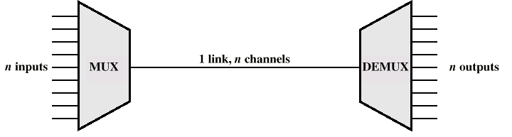
Multiplexing

Slide 3
Frequency Division Multiplexing
FDM
Useful bandwidth of medium exceeds required bandwidth of channel
Each signal is modulated to a different carrier frequency
Carrier frequencies separated so signals do not overlap (guard bands)
e.g. broadcast radio
Channel allocated even if no data

Slide 4
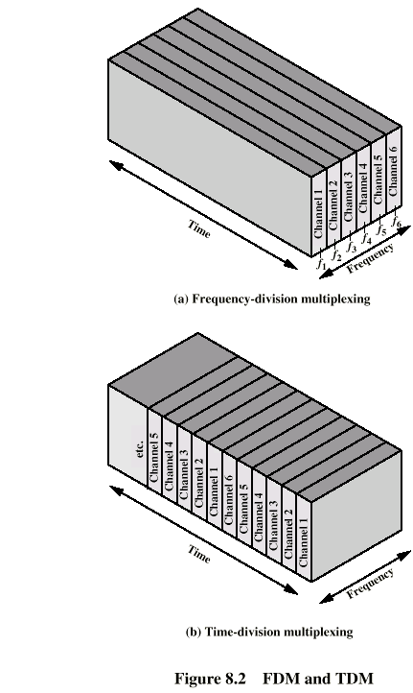
Frequency Division Multiplexing
Diagram

Slide 5
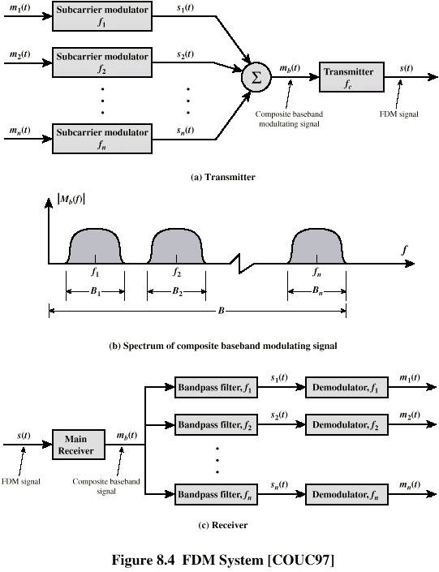
FDM System

Slide 6
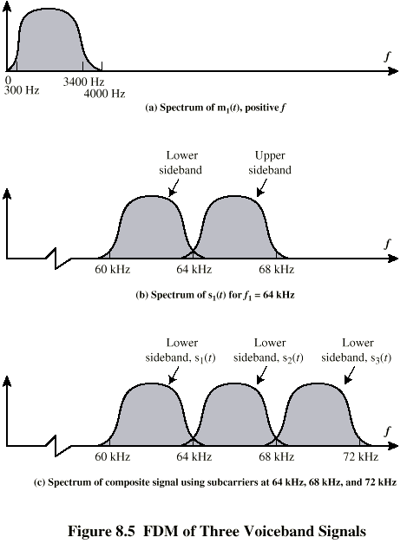
FDM of Three Voiceband Signals

Slide 7
Analog Carrier Systems
AT&T (USA)
Hierarchy of FDM schemes
Group
  12 voice channels (4kHz each) = 48kHz
  Range 60kHz to 108kHz
Supergroup
  60 channel
  FDM of 5 group signals on carriers between 420kHz and 612 kHz
Mastergroup
  10 supergroups

Slide 8
Wavelength Division Multiplexing
Multiple beams of light at different frequency
Carried by optical fiber
A form of FDM
Each color of light (wavelength) carries separate data channel
1997 Bell Labs
  100 beams
  Each at 10 Gbps
  Giving 1 terabit per second (Tbps)
Commercial systems of 160 channels of 10 Gbps now available
Lab systems (Alcatel) 256 channels at 39.8 Gbps each
  10.1 Tbps
  Over 100km

Slide 9
WDM Operation
Same general architecture as other FDM
Number of sources generating laser beams at different frequencies
Multiplexer consolidates sources for transmission over single fiber
Optical amplifiers amplify all wavelengths
  Typically tens of km apart
Demux separates channels at the destination
Mostly 1550nm wavelength range
Was 200MHz per channel
Now 50GHz

Slide 10
Dense Wavelength Division Multiplexing
DWDM
No official or standard definition
Implies more channels more closely spaced that WDM
200GHz or less

Slide 11
Synchronous Time Division Multiplexing
Data rate of medium exceeds data rate of digital signal to be transmitted
Multiple digital signals interleaved in time
May be at bit level of blocks
Time slots preassigned to sources and fixed
Time slots allocated even if no data
Time slots do not have to be evenly distributed amongst sources

Slide 12
Time Division Multiplexing

Slide 13
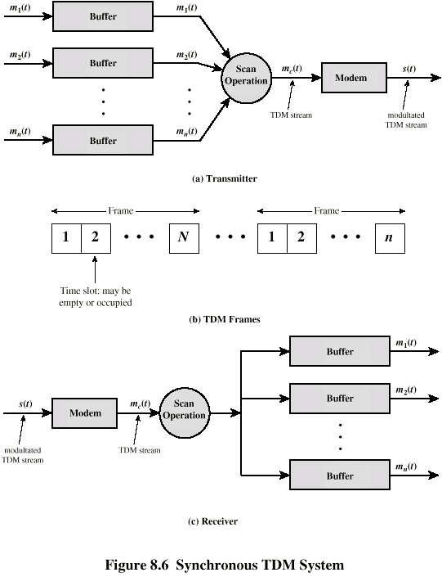
TDM System

Slide 14
TDM Link Control
No headers and trailers
Data link control protocols not needed
Flow control
  Data rate of multiplexed line is fixed
  If one channel receiver can not receive data, the others must carry on
  The corresponding source must be quenched
  This leaves empty slots
Error control
  Errors are detected and handled by individual channel systems

Slide 15
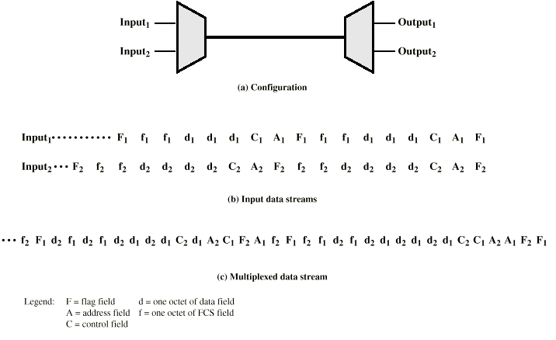
Data Link Control on TDM

Slide 16
Framing
No flag or SYNC characters bracketing TDM frames
Must provide synchronizing mechanism
Added digit framing
  One control bit added to each TDM frame
    Looks like another channel - “control channel”
  Identifiable bit pattern used on control channel
  e.g. alternating 01010101…unlikely on a data channel
  Can compare incoming bit patterns on each channel with sync pattern

Slide 17
Pulse Stuffing
Problem - Synchronizing data sources
Clocks in different sources drifting
Data rates from different sources not related by simple rational number
Solution - Pulse Stuffing
  Outgoing data rate (excluding framing bits) higher than sum of incoming rates
  Stuff extra dummy bits or pulses into each incoming signal until it matches local clock
  Stuffed pulses inserted at fixed locations in frame and removed at demultiplexer

Slide 18
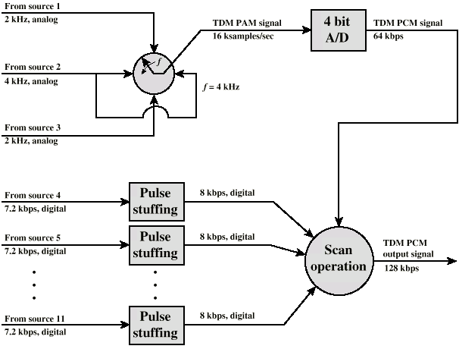
TDM of Analog and Digital Sources

Slide 19
Digital Carrier Systems
Hierarchy of TDM
USA/Canada/Japan use one system
ITU-T use a similar (but different) system
US system based on DS-1 format
Multiplexes 24 channels
Each frame has 8 bits per channel plus one framing bit
193 bits per frame

Slide 20
Digital Carrier Systems (2)
For voice each channel contains one word of digitized data (PCM, 8000 samples per sec)
  Data rate 8000x193 = 1.544Mbps
  Five out of six frames have 8 bit PCM samples
  Sixth frame is 7 bit PCM word plus signaling bit
  Signaling bits form stream for each channel containing control and routing info
Same format for digital data
  23 channels of data
    7 bits per frame plus indicator bit for data or systems control
  24th channel is sync

Slide 21
Mixed Data
DS-1 can carry mixed voice and data signals
24 channels used
No sync byte
Can also interleave DS-1 channels
  Ds-2 is four DS-1 giving 6.312Mbps

Slide 22
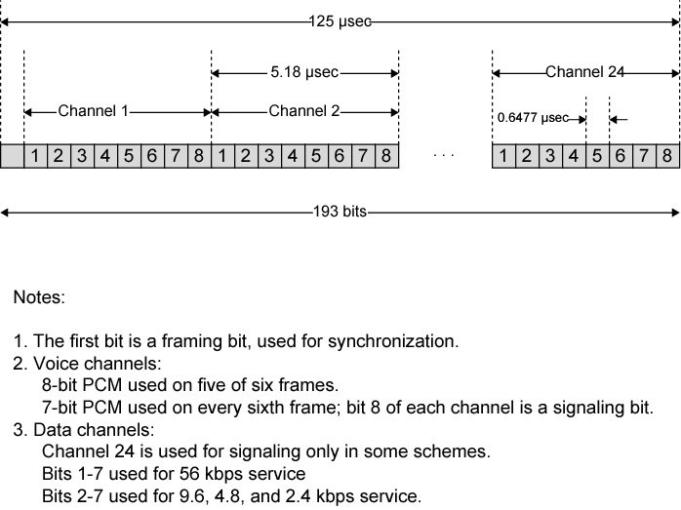
DS-1 Transmission Format

Slide 23
SONET/SDH
Synchronous Optical Network (ANSI)
Synchronous Digital Hierarchy (ITU-T)
Compatible
Signal Hierarchy
  Synchronous Transport Signal level 1 (STS-1) or Optical Carrier level 1 (OC-1)
  51.84Mbps
  Carry DS-3 or group of lower rate signals (DS1 DS1C DS2) plus ITU-T rates (e.g. 2.048Mbps)
  Multiple STS-1 combined into STS-N signal
  ITU-T lowest rate is 155.52Mbps (STM-1)

Slide 24
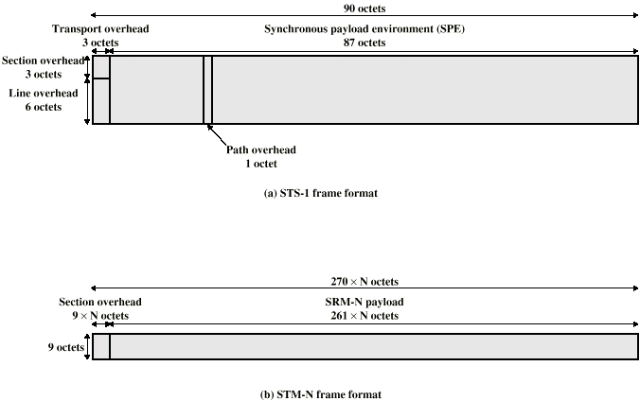
SONET Frame Format

Slide 25
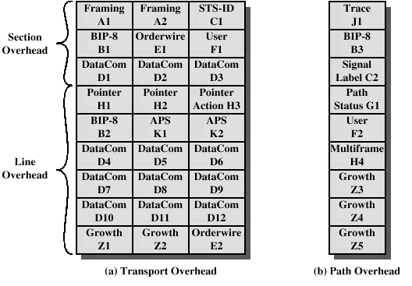
SONET STS-1 Overhead Octets

Slide 26
Statistical TDM
In Synchronous TDM many slots are wasted
Statistical TDM allocates time slots dynamically based on demand
Multiplexer scans input lines and collects data until frame full
Data rate on line lower than aggregate rates of input lines

Slide 27
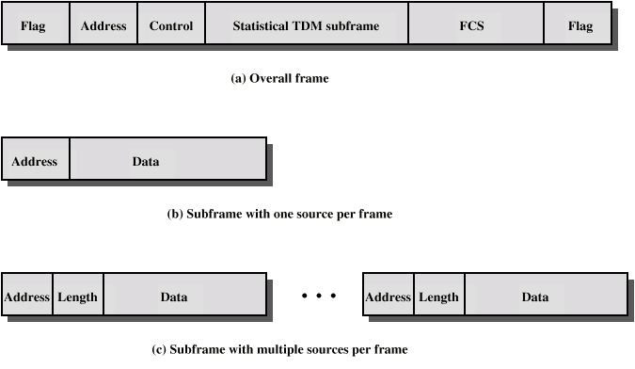
Statistical TDM Frame Formats

Slide 28
Performance
Output data rate less than aggregate input rates
May cause problems during peak periods
  Buffer inputs
  Keep buffer size to minimum to reduce delay

Slide 29
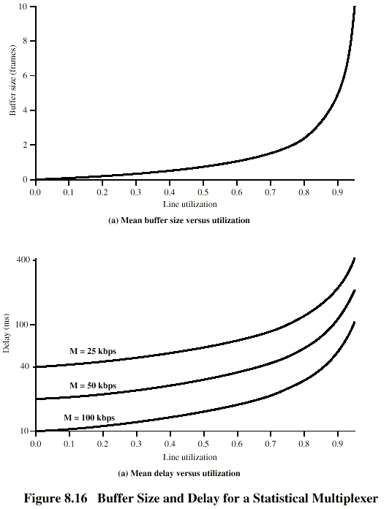
Buffer Size and Delay

Slide 30
Cable Modem Outline
Two channels from cable TV provider dedicated to data transfer
  One in each direction
Each channel shared by number of subscribers
  Scheme needed to allocate capacity
  Statistical TDM

Slide 31
Cable Modem Operation
Downstream
  Cable scheduler delivers data in small packets
  If more than one subscriber active, each gets fraction of downstream capacity
    May get 500kbps to 1.5Mbps
  Also used to allocate upstream time slots to subscribers
Upstream
  User requests timeslots on shared upstream channel
    Dedicated slots for this
  Headend scheduler sends back assignment of future tme slots to subscriber

Slide 32
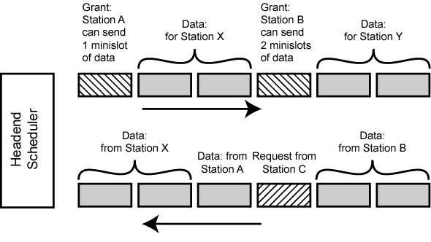
Cable Modem Scheme

Slide 33
Asymmetrical Digital Subscriber Line
ADSL
Link between subscriber and network
  Local loop
Uses currently installed twisted pair cable
  Can carry broader spectrum
  1 MHz or more

Slide 34
ADSL Design
Asymmetric
  Greater capacity downstream than upstream
Frequency division multiplexing
  Lowest 25kHz for voice
    Plain old telephone service (POTS)
  Use echo cancellation or FDM to give two bands
  Use FDM within bands
Range 5.5km

Slide 35
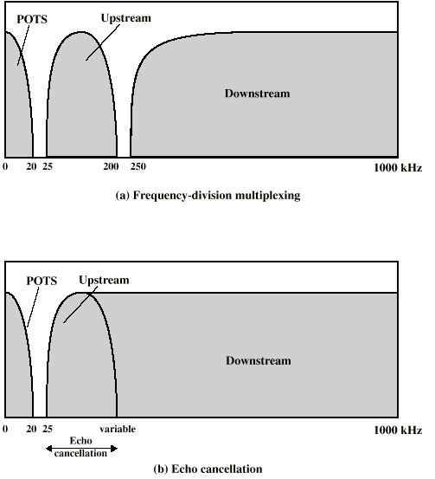
ADSL Channel Configuration

Slide 36
Discrete Multitone
DMT
Multiple carrier signals at different frequencies
Some bits on each channel
4kHz subchannels
Send test signal and use subchannels with better signal to noise ratio
256 downstream subchannels at 4kHz (60kbps)
  15.36MHz
  Impairments bring this down to 1.5Mbps to 9Mbps

Slide 37
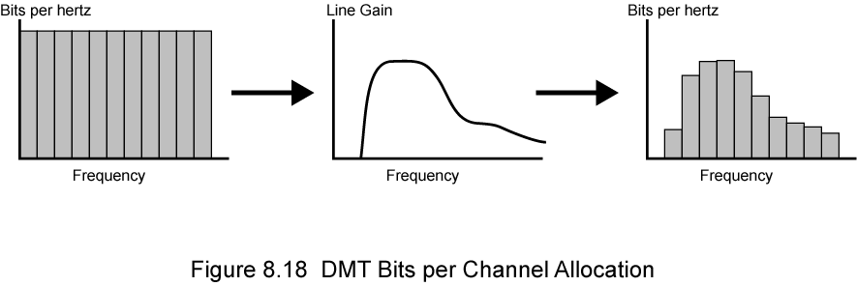
DTM Bits Per Channel Allocation

Slide 38
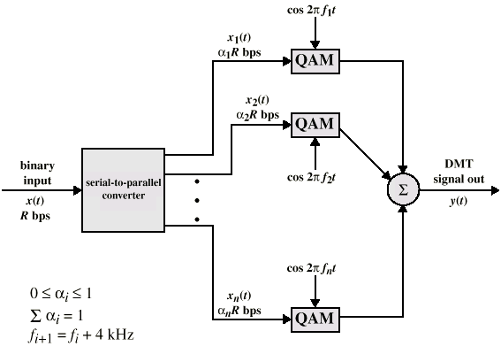
DMT Transmitter

Slide 39
xDSL
High data rate DSL
Single line DSL
Very high data rate DSL

Slide 40
Required Reading
Stallings chapter 8
Web sites on
  ADSL
  SONET

